Slide 1
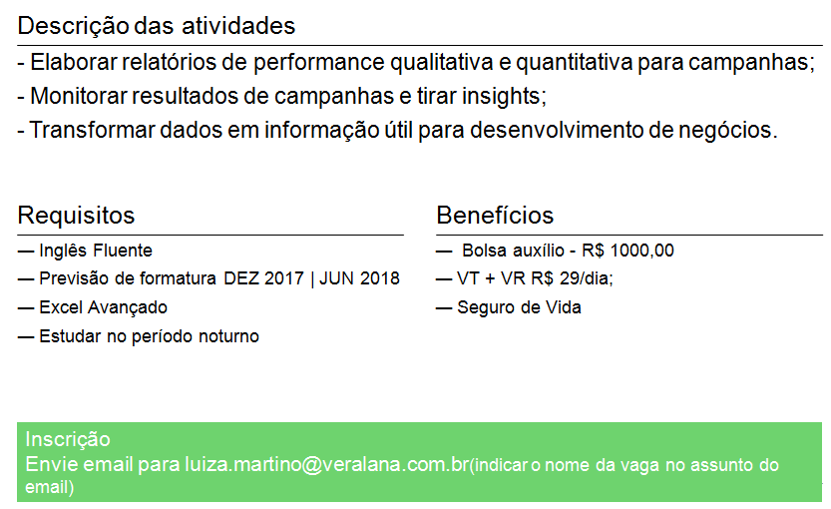
ALMAP BBDO Business Intelligente | Accountability

