Slide 1
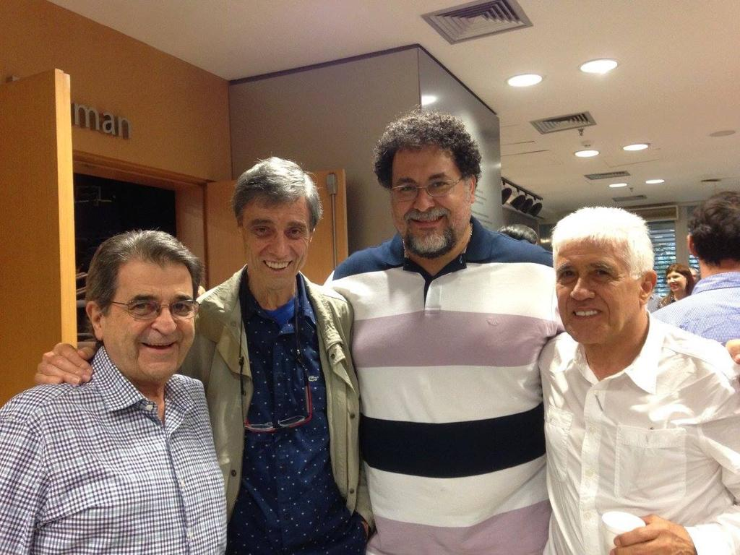
Statistics, Data Science and Decision
Workshop on big Data, big noise and big statistics
November 2015
https://livestream.com/insper/Workshop-on-big-Data

